Slide 1
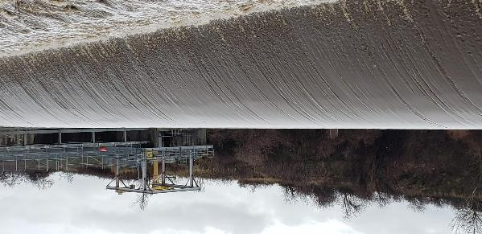
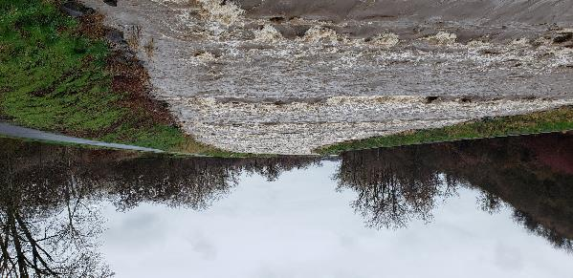
Mill creek GI public meeting
Tracy Schwarz, PE, PMP
Hydrology and Hydraulics
Walla Walla District
Date: 12 Feb 2020

Slide 2
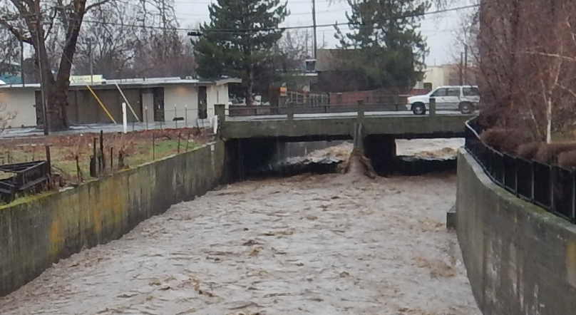
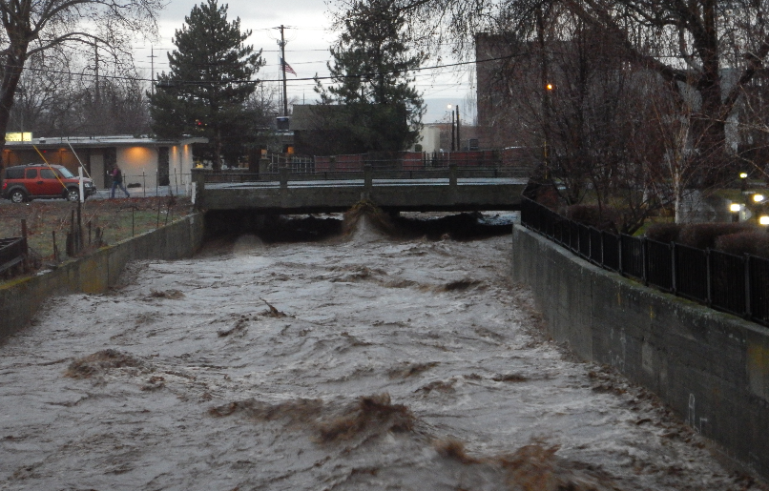
Alternative screening
Trade off analysis (Jan – may 2019)
Looked to determine most cost effective alternative to meet the same target flood risk protection. For this analysis there was no need for economics as each comparison targeted the same benefit.
Started with New Projects:
The bypass channel was significantly more cost effective than a new dam
 | Design Flood Risk Management | New Storage (acre-feet) | New By-Pass Channel Capacity (cfs) | Flow through levee/concrete channel reach (cfs)
New Large Dam | 0.1-Percent (1,000 year) | 29,000 | N/A | 1,400
New Large Bypass Channel | 0.1-Percent (1,000 year) | N/A | 4,700 | 1,400
New Small Dam | 0.1-Percent (1,000 year) | 12,800 | N/A | 3,500
New Small Bypass Channel | 0.1-Percent (1,000 year) | N/A | 2,600 | 3,500
1,400 cfs
3,500 cfs
¹ Frequency based on 2008 regulated frequency curve in the Mill Creek water control manual
² 40% Hydraulic Modeling

Slide 3
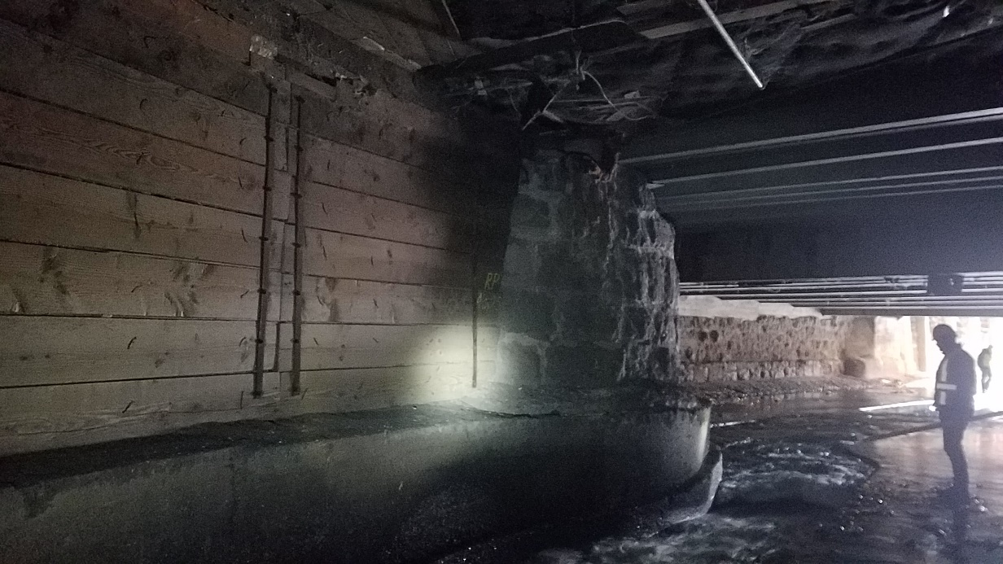
Alternative screening
Trade off analysis (jan-may 2019)
Next looked at concrete channel rehab verses a new project:
This showed it was significantly more cost effective to Rehab than build a new project to mitigate.
 | Design Flood Risk Management | New Storage (acre-feet) | New By-Pass Channel Capacity (cfs) | Flow through levee/concrete channel reach (cfs)
Rehab | 0.5-percent (200 year) | N/A | N/A | 3,500
New Dam | 0.5-percent (200 year) | 11,000 | N/A | 1,400
New Bypass Channel | 0.5-percent (200 year) | N/A | 1,800 | 1,400
¹ Frequency based on 2008 regulated frequency curve in the Mill Creek water control manual
² 40 % Hydraulic Modeling

Slide 4
Alternative screening
Trade off analysis (jan-may 2019)
Looked at small, medium and large scaled enhancements to existing project:
Dam raise was consistently more expensive for same benefits
Levee setback reaches were too short to offer flood risk reduction, also desired vegetation would negate any benefits if a long reach were found.
Project Tradeoff | Project Alternative | Flood Risk Target¹ | Project Change
Small Modification to Existing Project | Small Dam Raise | 0.43-Percent (230 year) | 2 foot raise
 | Small Excavation | 0.43-Percent (230 year) | 462 acre-feet
 | Small Levee Raise | 0.43-Percent (230 year) | 3,700 cfs
Moderate Modification to Existing Project | Moderate Dam Raise | 0.37-Percent (270 year) | 5 foot raise
 | Moderate Excavation | 0.37-Percent (270 year) | 1,188 acre-feet
 | Moderate Levee Raise | 0.37-Percent (270 year) | 4,000 cfs (max without bridge backwater)
Large Modification to Existing Project | Large Dam Raise | 0.32-Percent (310 year) | 9 foot raise (max valley capacity)
 | Large Excavation | 0.32-Percent (310 year) | 2,209 acre-feet
 | Large Levee Raise | 0.32-Percent (310 year) | 4,300 cfs (raise bridges)
Levee Setback verses Levee Raise | Levee Setback verses Raise | Varies | Levee setback at equal height
¹ Frequency based on 2008 regulated frequency curve in the Mill Creek water control manual
² 40% Hydraulic Modeling

Slide 5
Alternative screening
Maximum Benefit (jan-may 2019)
Maximum Benefit
  Rough 1000 year inundation model and damages were calculated as a upper bound to what could be afforded by the project.
    Used no Breach, Tunnel blockage, wall failure and levee failure scenarios.
    Economics modeling
  Screened out all new dams and bypasses. Screened out large changes to existing project
What was left after Trade-Off Analysis and Maximum Benefit Analysis
  Channel Rehab of Concrete Channel
  Small Excavation
  Small Levee Raise
  Moderate Excavation
  Moderate Levee Raise
  Operational Changes (no-cost change)

Slide 6
Alternative screening
70% Modeling leading to tsp
(June – September 2019)
Reservoir Operations Model
Updated Frequency Curve
  including multi-peaks in a Monte Carlo approach to scaling existing events to a larger array
  200 year changed to 175 year for maintaining 3,500 cfs capacity (increased risk)
Updated Hydraulic Model (including failure scenarios)
Economics modeling
Alternatives studied
  Rehab of concrete channel (included as a part of each of the following alternatives)
  Small Excavation
  Small Levee Raise
  Moderate Excavation
  Moderate Levee Raise
  Small Excavation and Small Levee Raise
  Operational Changes (no-cost change)
TSP – Operations Change, Levee Raise and Rehab

Slide 7
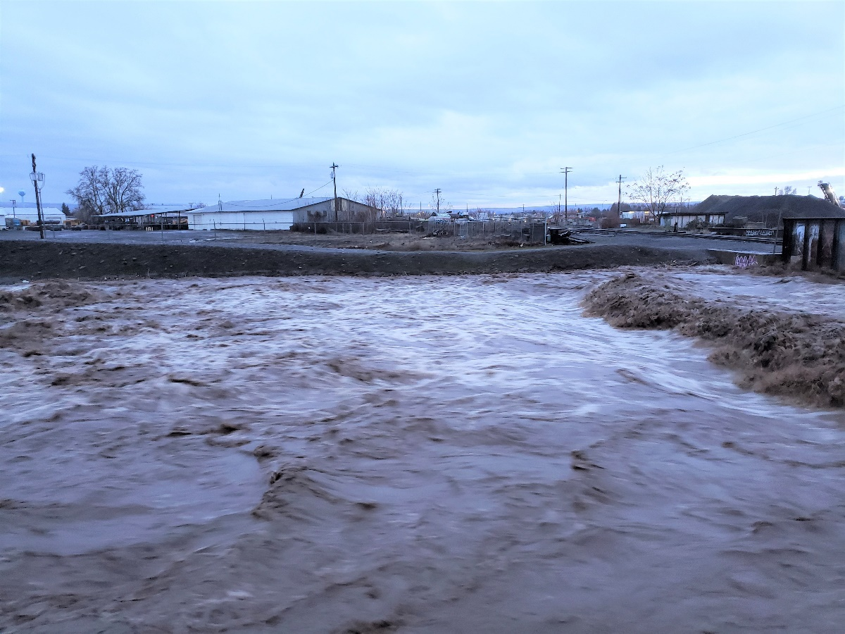
TSP – Operations change, small levee raise, Rehab
(October - december 2019)
Based on 70% modeling

Slide 8
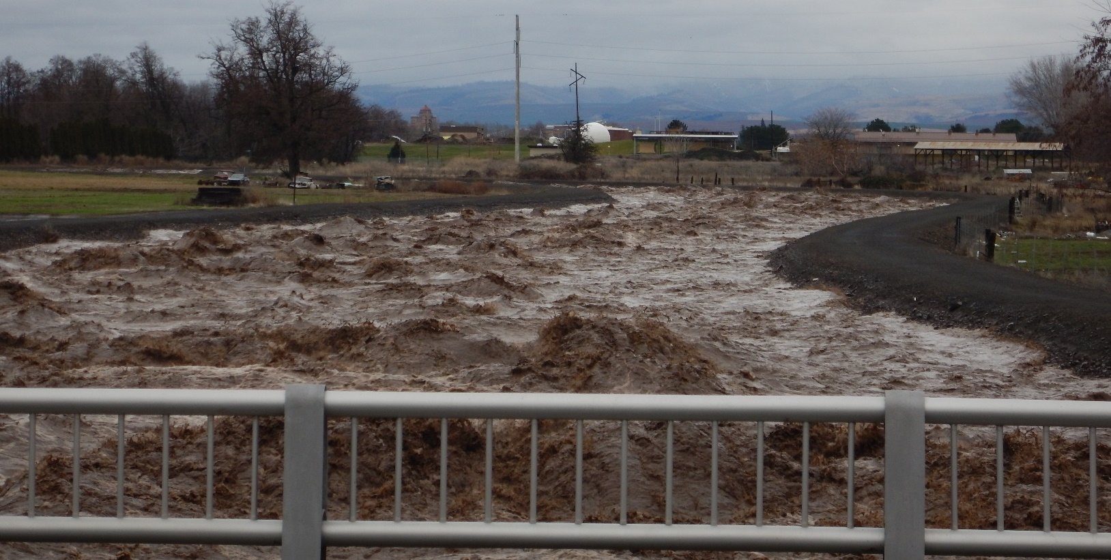
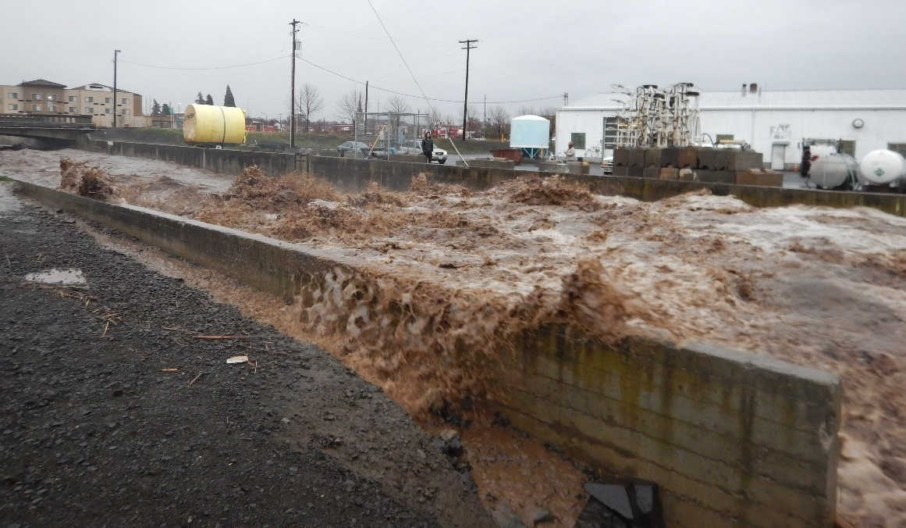
Why a Levee Raise?
We just passed over 3,900 cfs February 7, 2020. Why do we need to raise the levees for 3,700 cfs?
Levees need freeboard for uncertainty.
Uncertainty in operations/hydrology
  Intent was to limit flows to 3,800 cfs through town.
  Fluctuation in flows 3,600-4,100 cfs
Uncertainty in hydraulics
  Waves
  Friction
  Banking
Waves Downstream 9th and upstream Gose Street

Slide 9
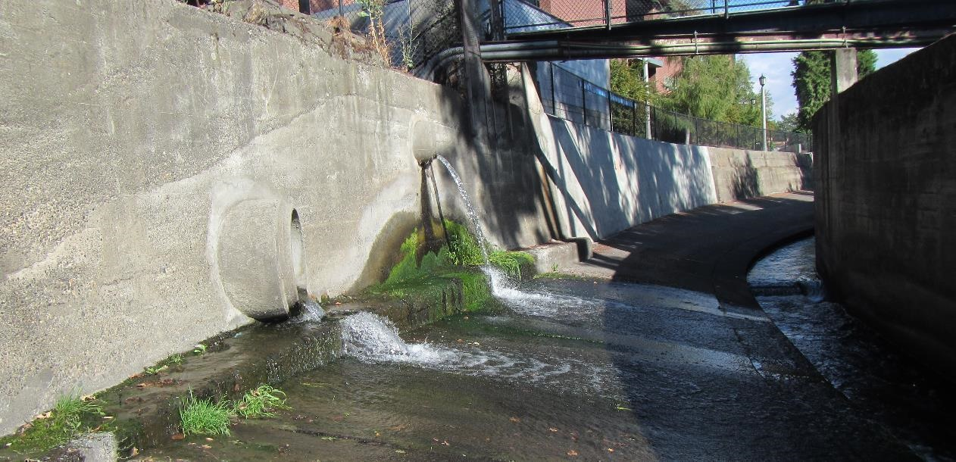
Questions!

Slide 10
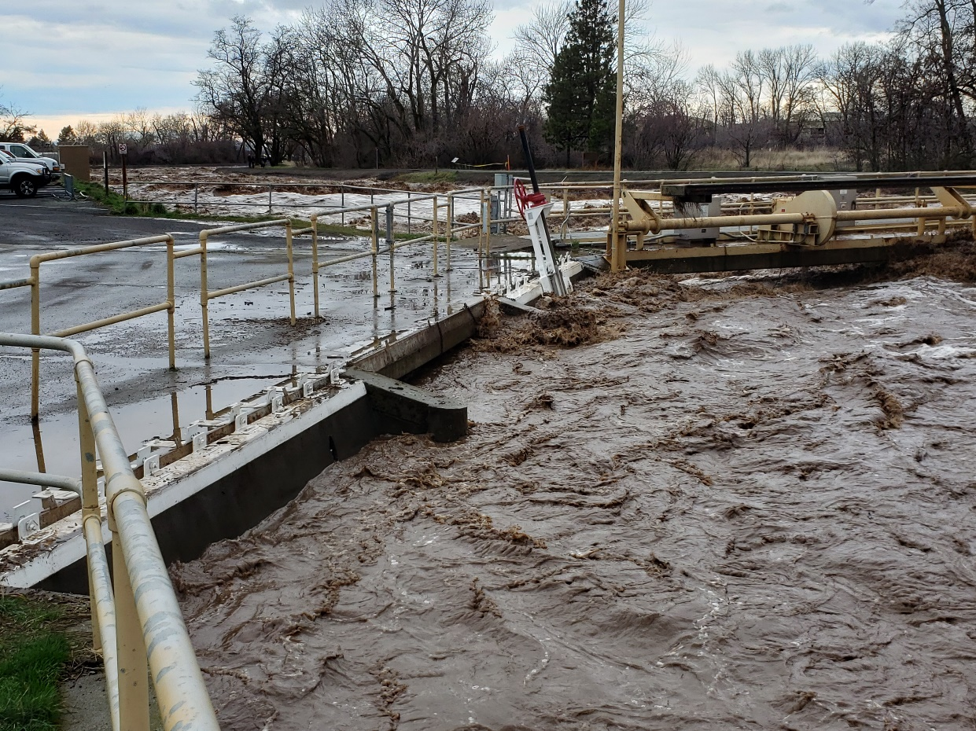
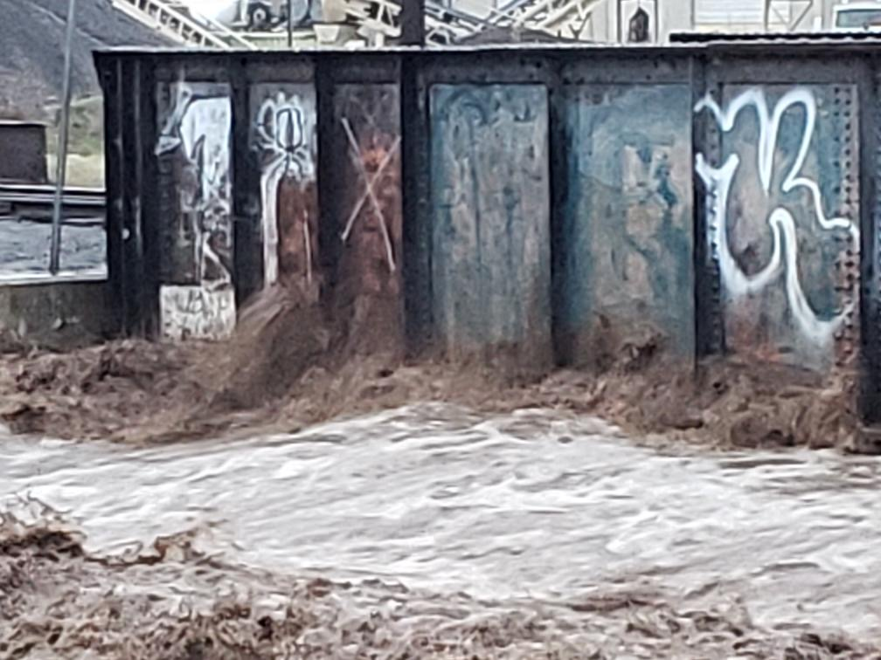

Slide 11
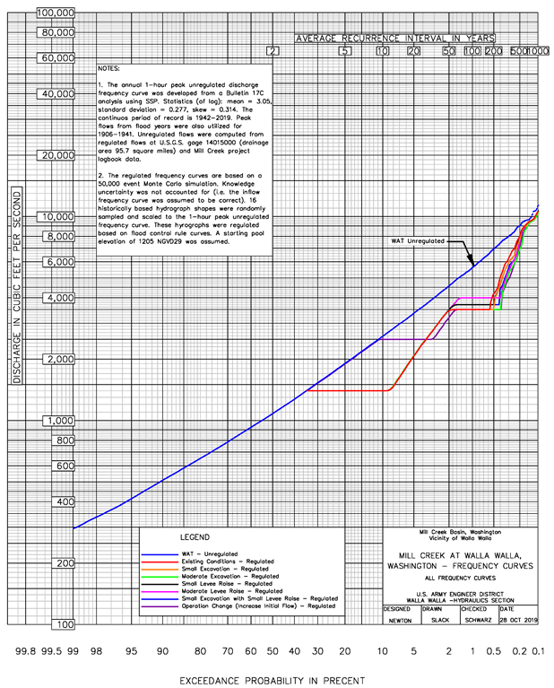

Slide 12
Existing Conditions levee assessment
(June – September 2019)
Critical Index Cross Section | Damage Reach | Conditional Non-Exceedance Probability 1% Exceedance Flood (3,500 cfs) | Levee Raise Required to meet 0.85 Probability for Levee Certification (feet)
12.2216 | Division Works to Dam | 0.982 | 0.0
10.9688 | Tausick to Division Works | 0.918 | 0.0
10.3597 | Wilber to Tausick | 0.873 | 0.0
9.8223 | Roosevelt to Wilber | 0.979 | 0.0
7.3084 | Myra to 9th | 0.842 | 0.2
5.607 | Gose to Myra | 0.891 | 0.0
Based on 70% modeling

Slide 13
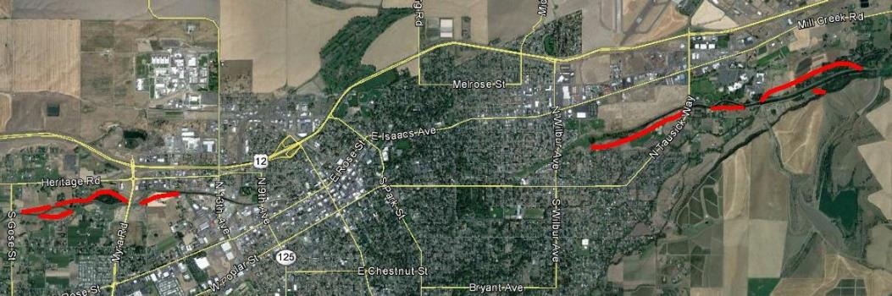
Option 3 – Setback Levee
Length – 17,400 feet Upstream + Middle + Downstream

